Slide 1
Indus River
Submitted By ; Shahar Yar
2019-ag-8973

Slide 2
Contents
Introduction
History
River Capacity
Structure
Area Irrigated by Indus River
Pollution

Slide 3
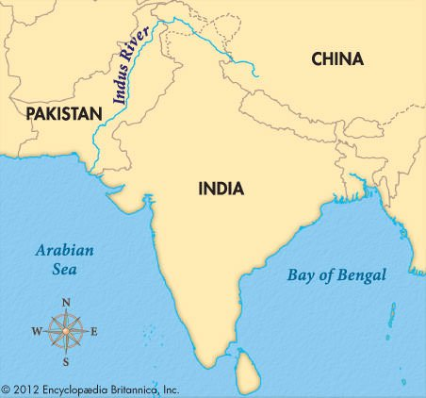
Introduction
Indus River is a great trans-Himalayan river of South Asia.
longest rivers with a length of some 2,000 miles (3,200 km).
Total drainage area is about
450,000 square miles.
Annual flow 58 cubic miles

Slide 4
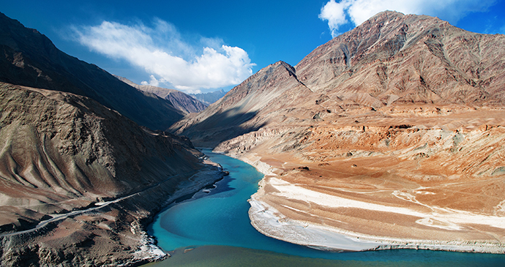
History
Indus River originates in Tibet.
At least 8,000 years old.
The river's conventional name derives from the Tibetan and Sanskrit name Sindhu.

Slide 5
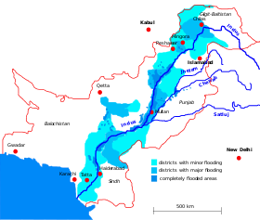
River Capacity
Receives an average annual water inflow of about 146 MAF.
Mostly derived from snow and glacial melting.
Pakistan's current water availability at various canal head works is about 97.71 MAF with estimated annual losses of 48.29 MAF.

Slide 6
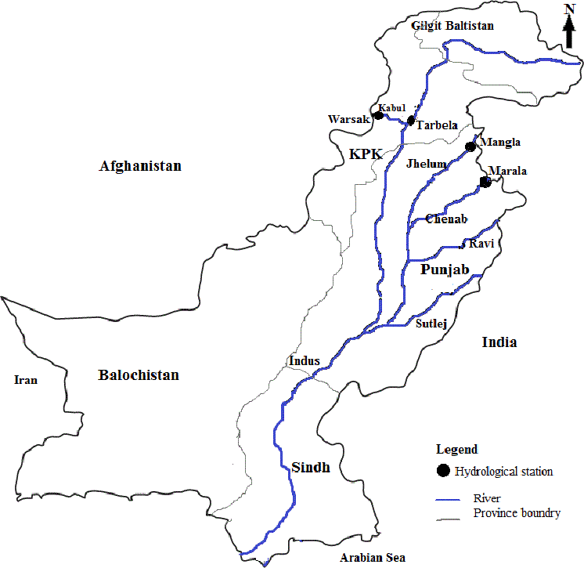
Structure
In Pakistan currently there are six barrages on the Indus.
(Guddu Barrage, Sukkur Barrage, Kotri Barrage, Taunsa Barrage, Chashma Barrage and Jinnah Barrage)
Tarbela is only reservoir on Indus River.

Slide 7
Area Irrigated by Indus River
The Indus River System (IRS) was developed into a complex network of canals.
74% of its water was utilized for irrigation
During the period of British administration, large canal systems were constructed.
8.5 to 18.2 MH in Pakistan and 2.02 to 8.5 MH in India.

Slide 8
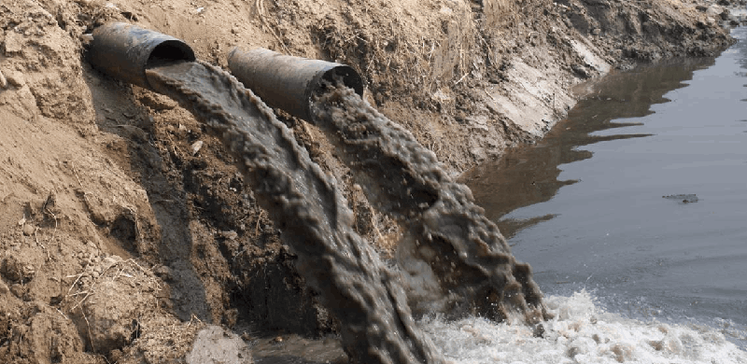
Pollution
The Indus River is the second most polluted river with plastic in the world.
Contributes 164,332 tonnes of plastic waste (to the sea) annually.
Return flow from agriculture.

Slide 9
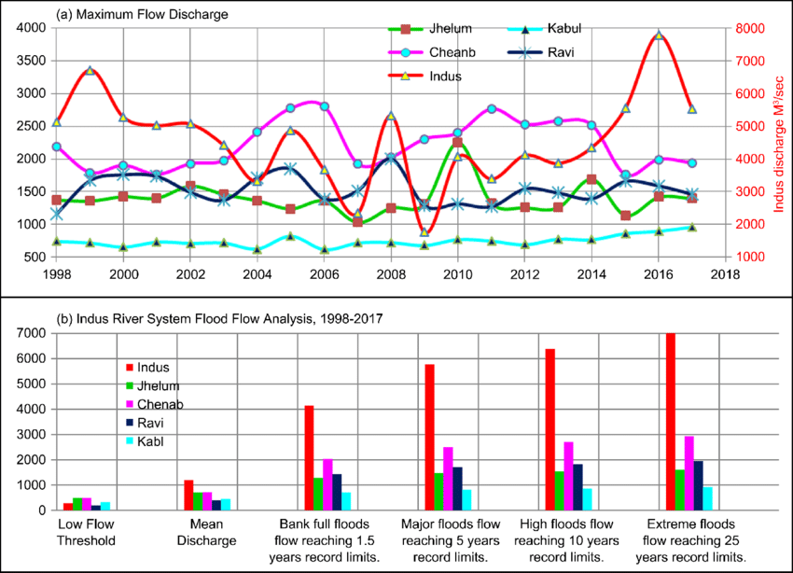
Maximum Flow Discharge Analysis

Slide 10
Thanks

